Slide 1




Backend - Java
https://github.com/geothm/LABS1-live.git

Slide 2

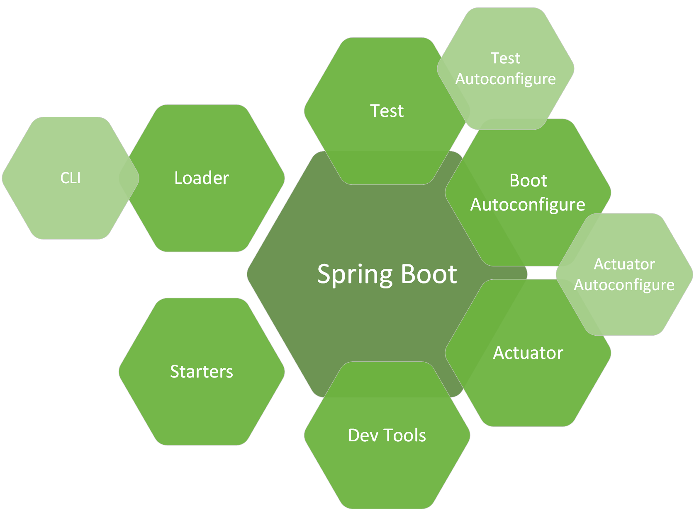
Spring Boot

Slide 3
spring-boot-starter-actuator
localhost:8080/actuator/health

Slide 4
spring-boot-starter-web
Tomcat?
Servlet?
@RestController
@GetMapping
Notes:
Ex 1 - start a spring boot application + custom controller

Slide 5

Layered architecture

Slide 6
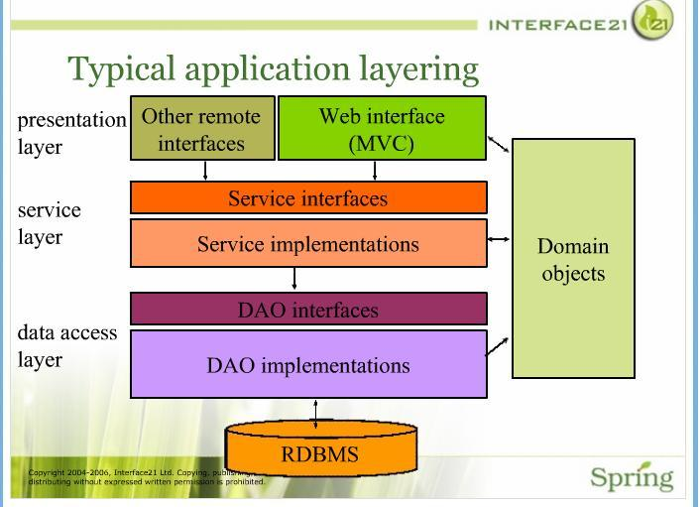

Slide 7
Architecture?
Modules
Dependencies
Build

Slide 8
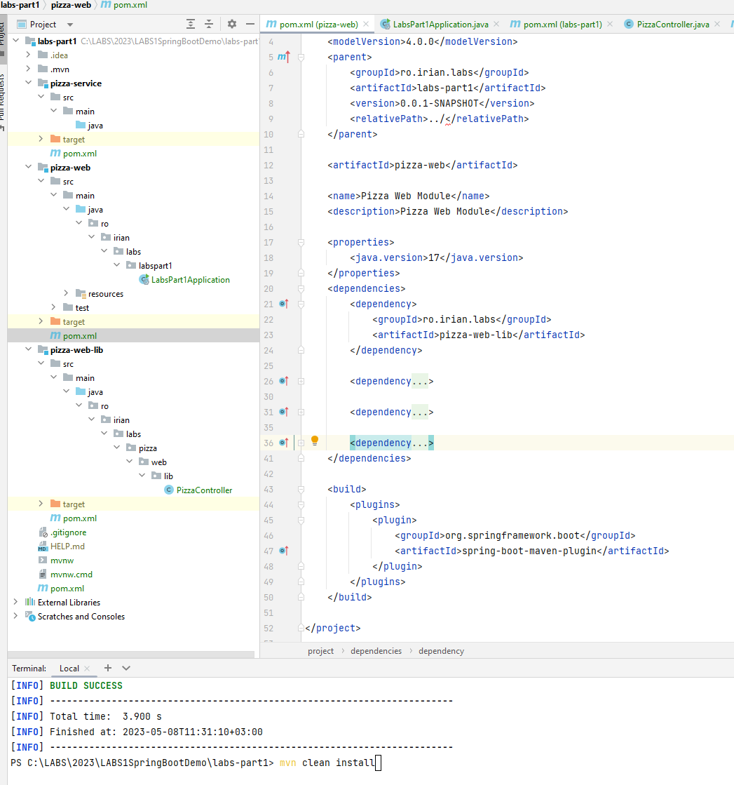
Notes:
Ex 2 - make modules for pizza-service, pizza-web-lib, pizza-web + master pom

Slide 9
Where are the pizzas?
Spring beans - @RestController etc
@Scope
@ComponentScan(basePackages = “”)
Notes:
Ex 3 - make Pizzas work

Slide 10
Make some pizza
Dependency Injection
@Autowired
Constructor injection
Notes:
Ex 3 - Create Pizza Service, inject into Pizza Controller

Slide 11
Different pizza providers?
Collect into controller all pizzas from different services (ItalianPizzaService, AmericanPizzaService)
Notes:
Ex 3 - Create Pizza Service, inject into Pizza Controller

